Slide 2
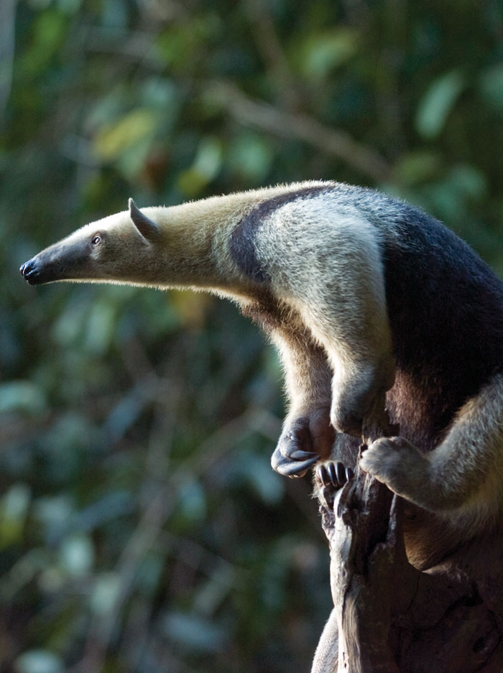
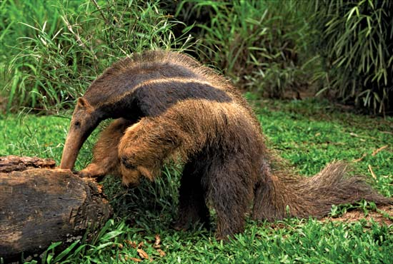
Xenarthra: Anteaters (4 sp)

Slide 3
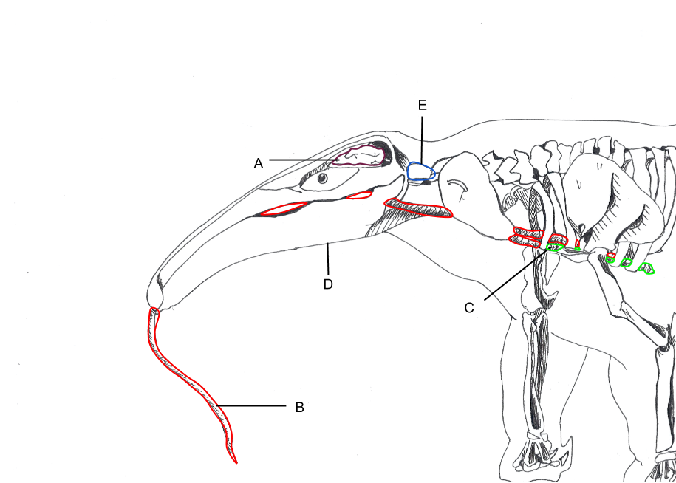
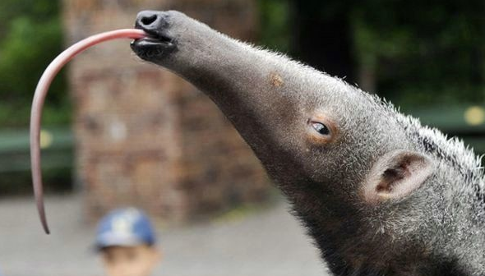
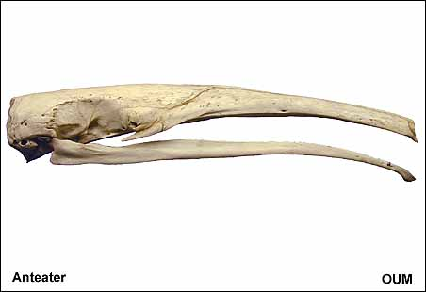
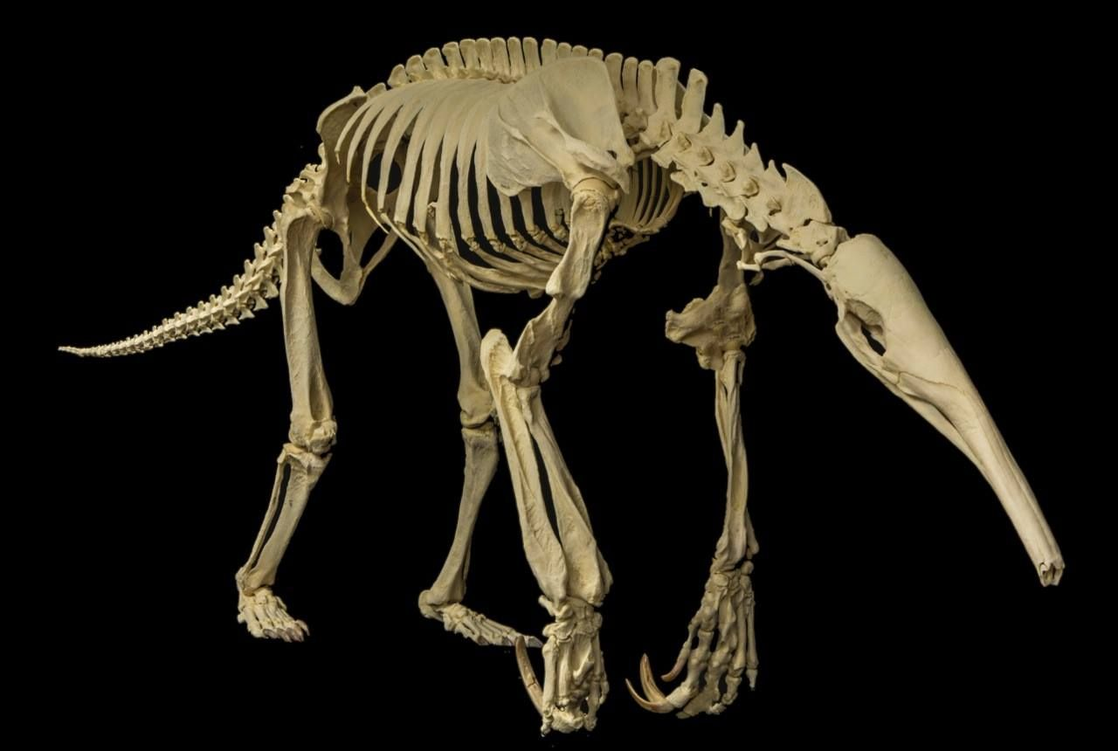
Xenarthra: Anteaters

Slide 4
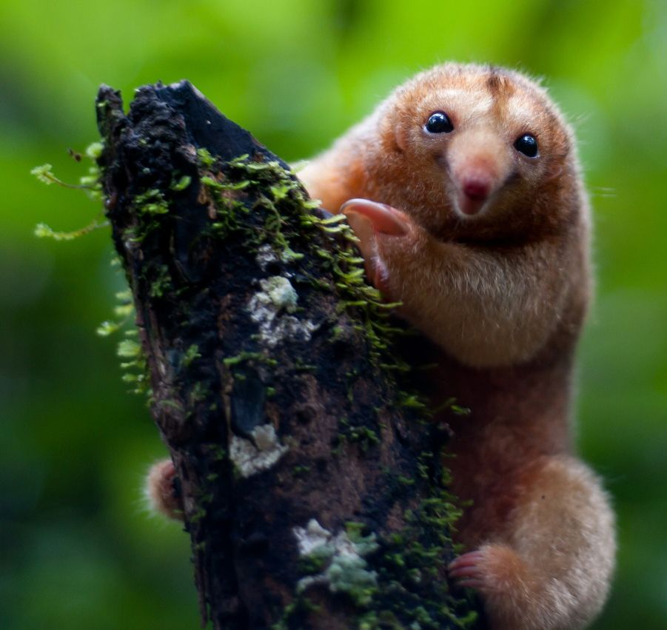
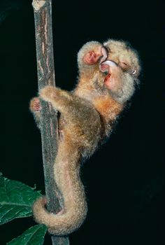
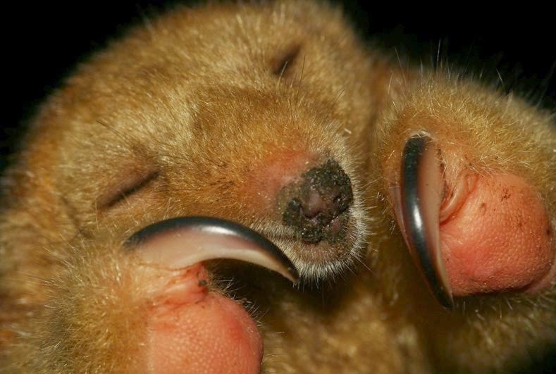
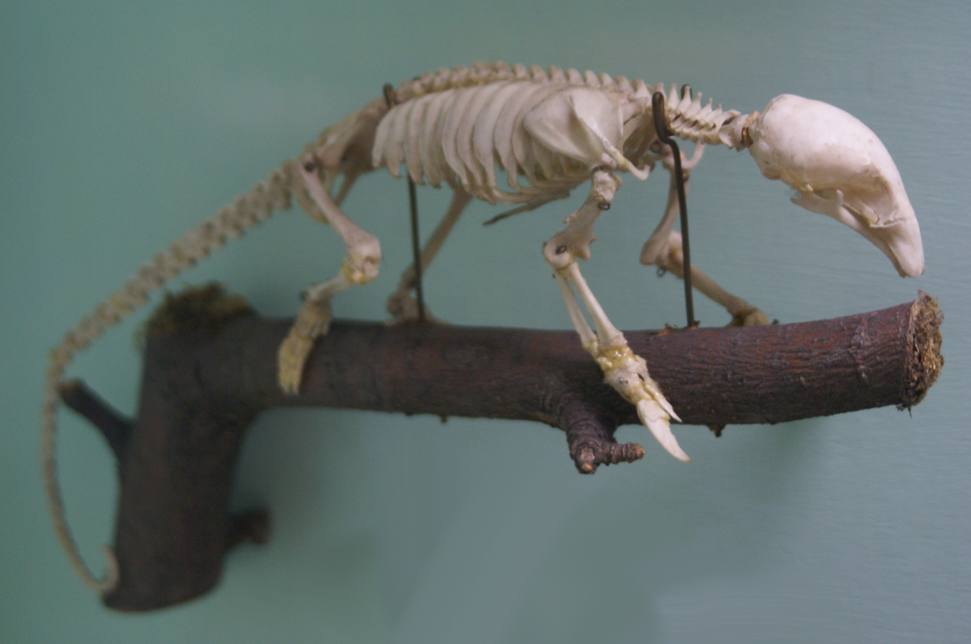
Xenarthra: Pilosa: Myrmecophaga: Cyclopes didactylus
Notes:
https://www.youtube.com/watch?v=pyCADk5tnxU

Slide 5
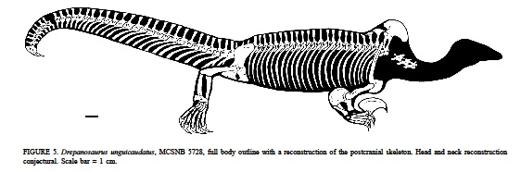
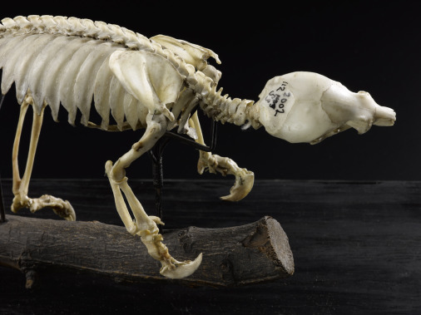
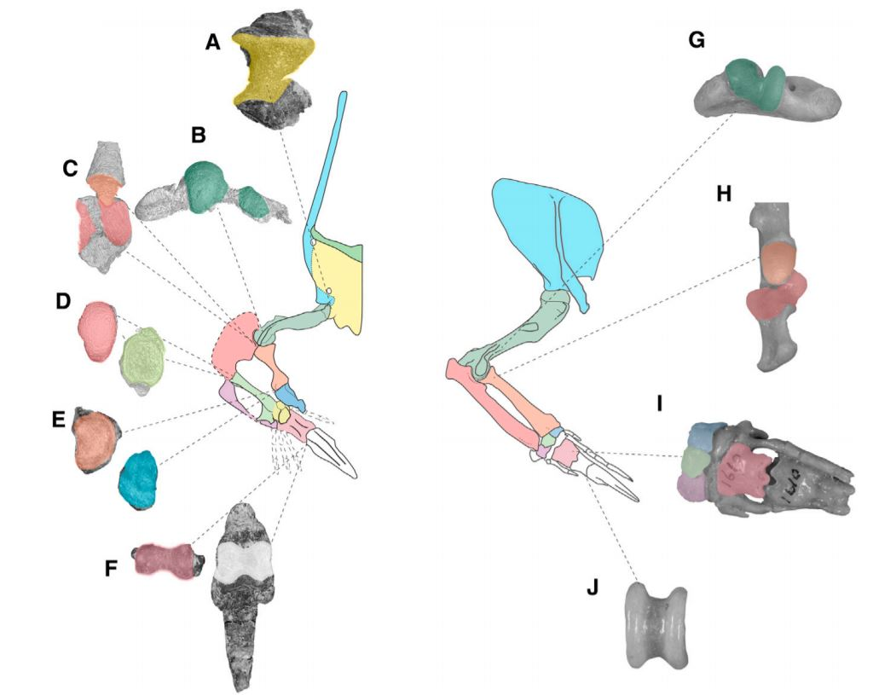
Xenarthra: Pilosa: Myrmecophaga: Cyclopes didactylus
Notes:
(A–J) Articular morphology of the bones of the Drepanosaurus (A–F) and Cyclopes forelimbs (G–J), illustrating osteological limitations to range of motion. Illustration of Cyclopes forelimb based on AMNH M 139228, YPM M 13499, and [42]. (A) Right glenoid fossa of GR 737 in lateral view, with strong dorsal and ventral margins limiting motion to protraction and retraction. (B) Right humerus of GR 737 in distal view, with strongly differentiated distal condyles. (C) Right radius and ulna of GR 737 in proximal view, with large and differentiated ulnar cotyles for reception of humeral condyles, restricting motion to flexion and extension. Also note the proximal process of the radius fitting into a notch in the ulna, restricting pronation and supination. (D) Right ulna (distal view) and right intermedium (proximal view of GR 737), with distinct ball-insocket joint. (E) Left radius (distal view, mirrored) and left radiale (proximal view, mirrored) of GR 736, with screw-shaped articulation seemingly preventing any motion. (F) Right metacarpal II (distal view) of GR 738 and left manual ungual (proximal view, mirrored) of GR
(G) Right humerus of YPM M 13499 (distal view), showing well-differentiated condyles. (H) Right radius and ulna of YPM M 13499 (proximal view), showing well-differentiated cotyles. (I) Right manus of AMNH M 139228 in dorsal view, illustrating tight-fitting and motion-restricting articulations of metacarpophalangeal and interphalangeal joints of the expanded manual digit III. (J) Right penultimate phalanx of digit III of AMNH M 139228 in distal view, illustrating the well-differentiated distal condyles.

Slide 6
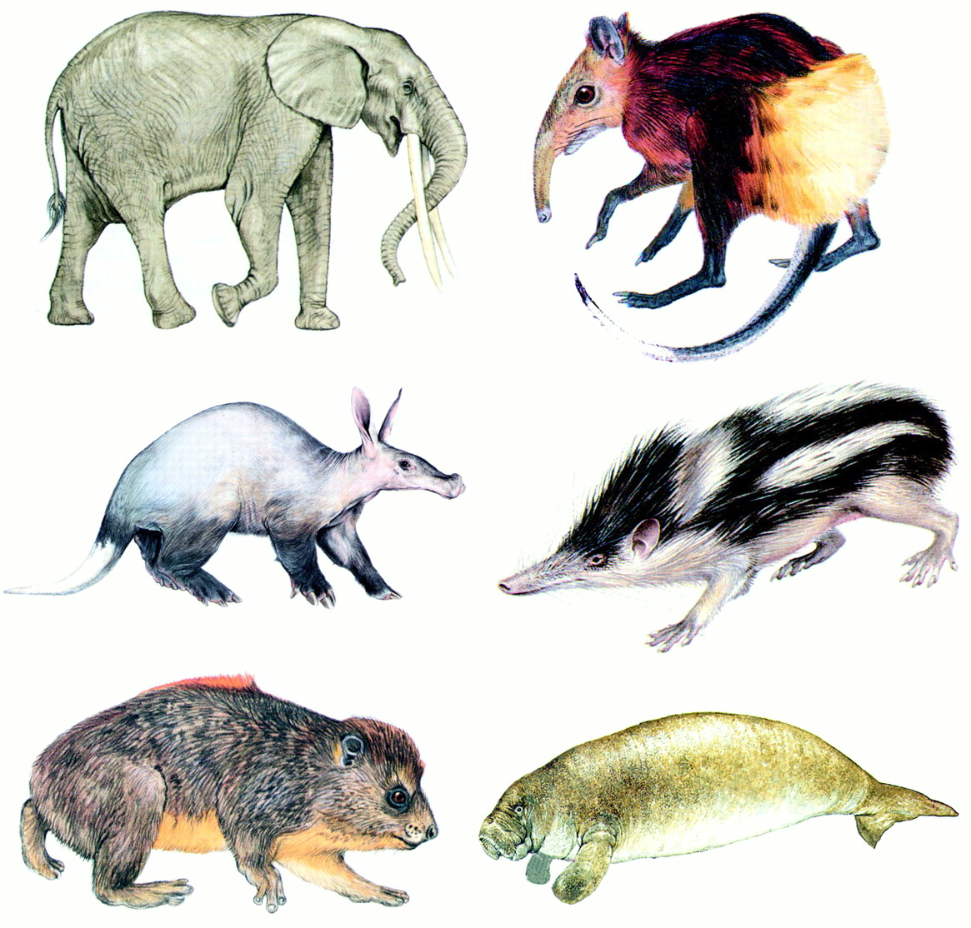
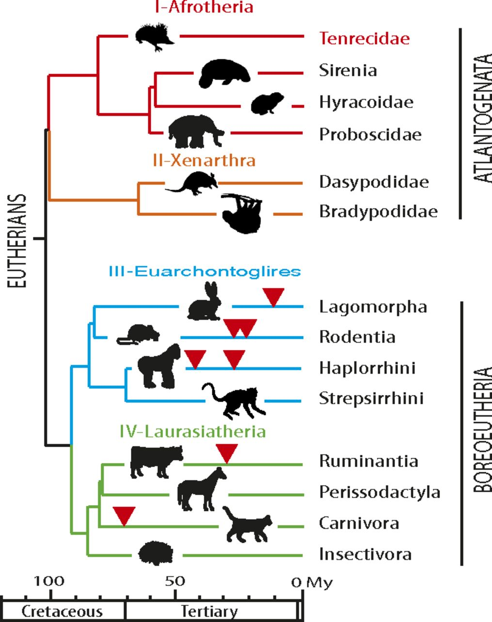
Afrotheria

Slide 7
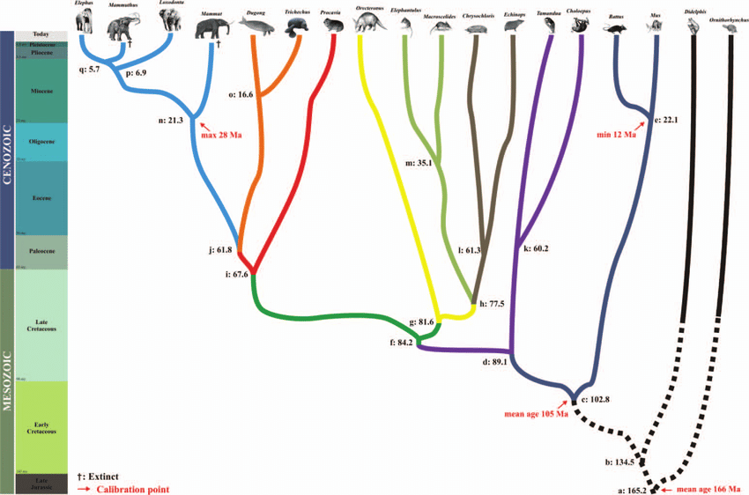
Afrotheria

Slide 8
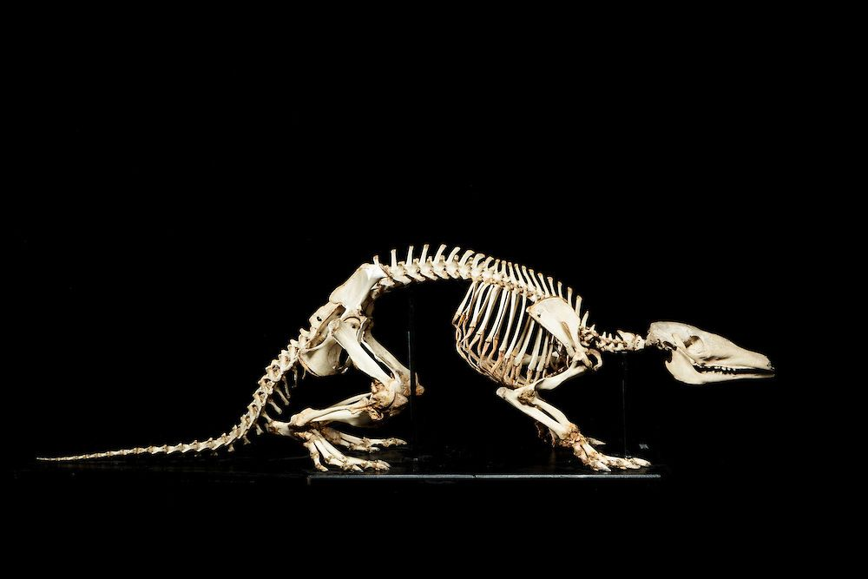
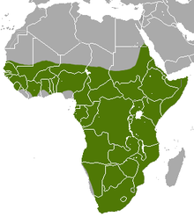
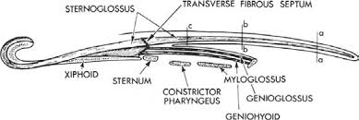
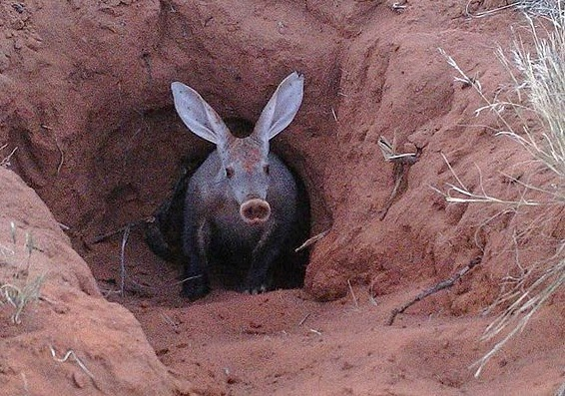
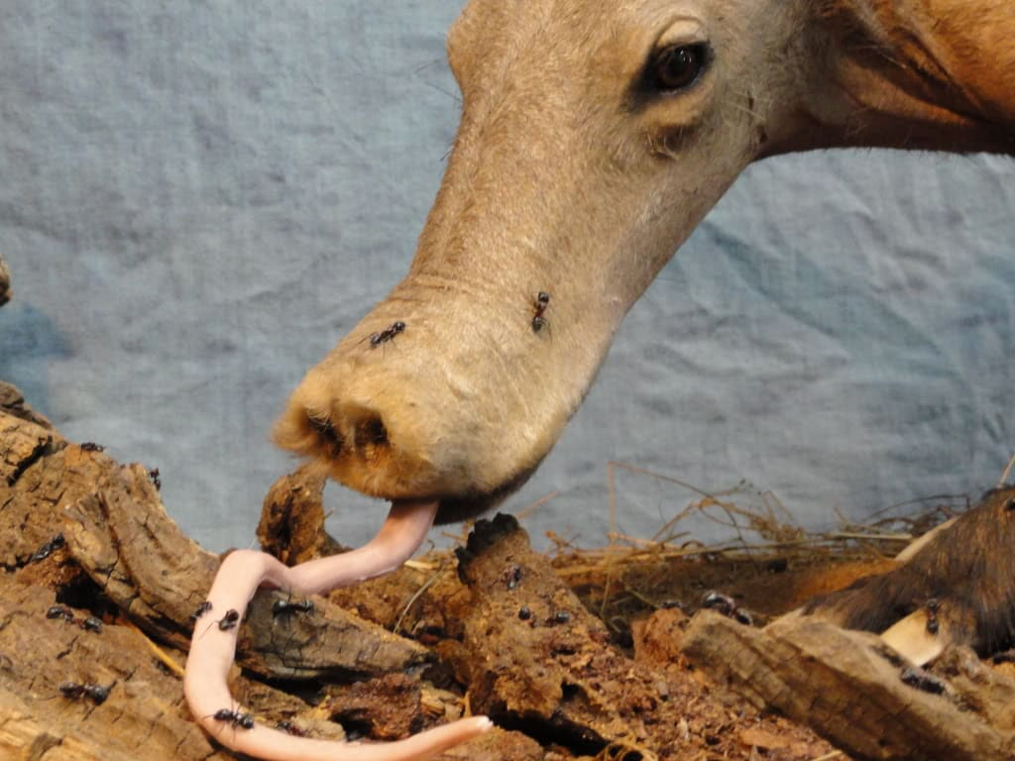
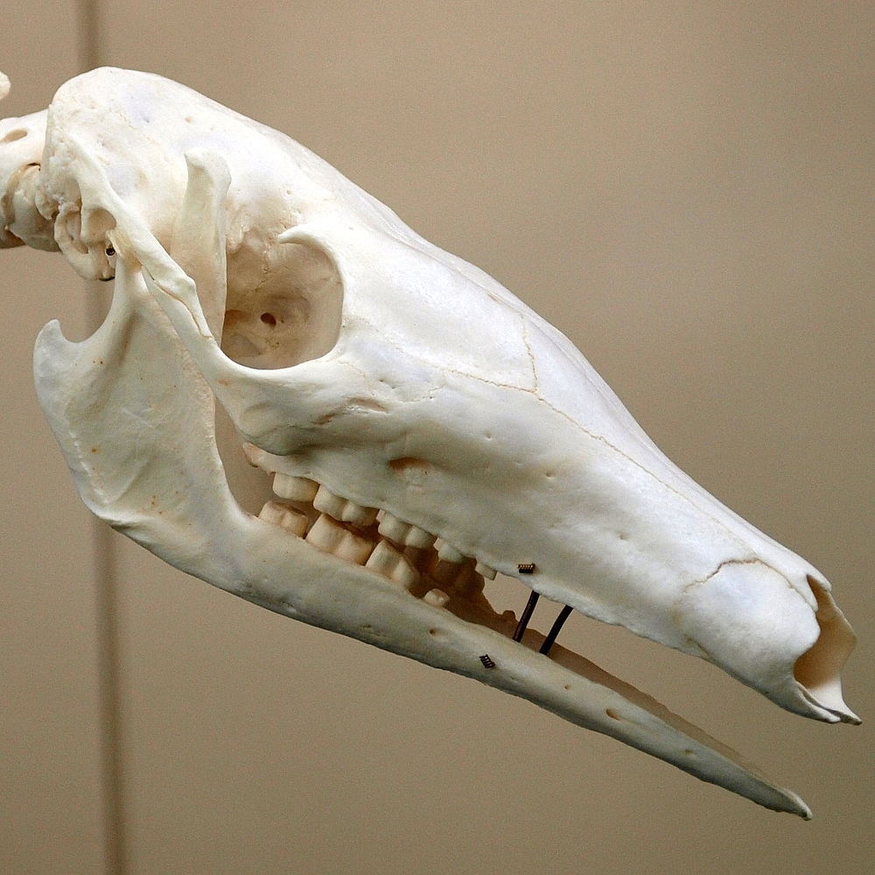
Afrotheria: Aardvark

Slide 9
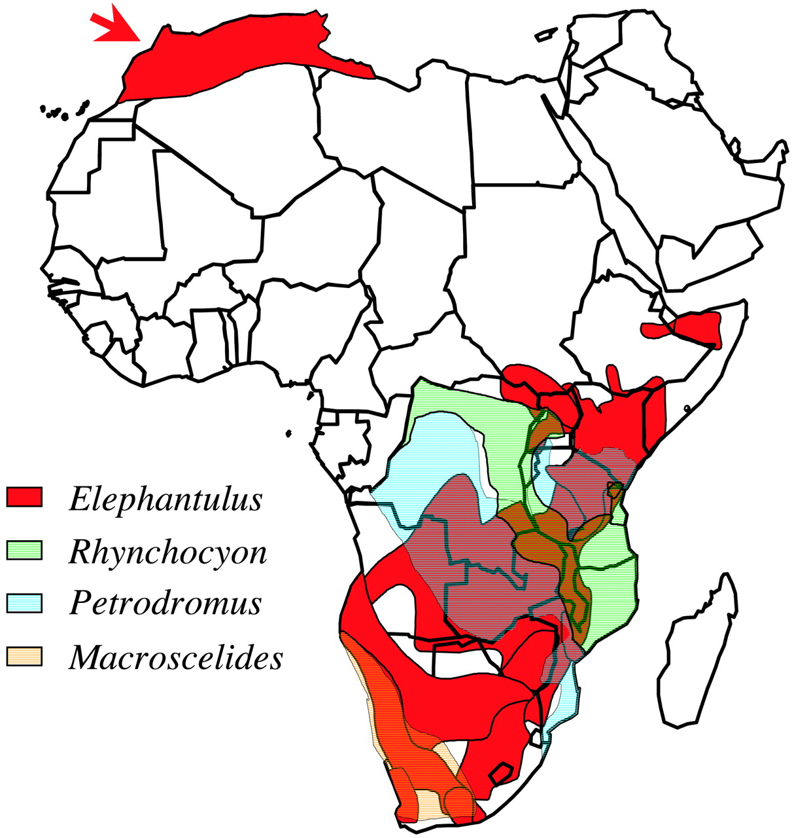
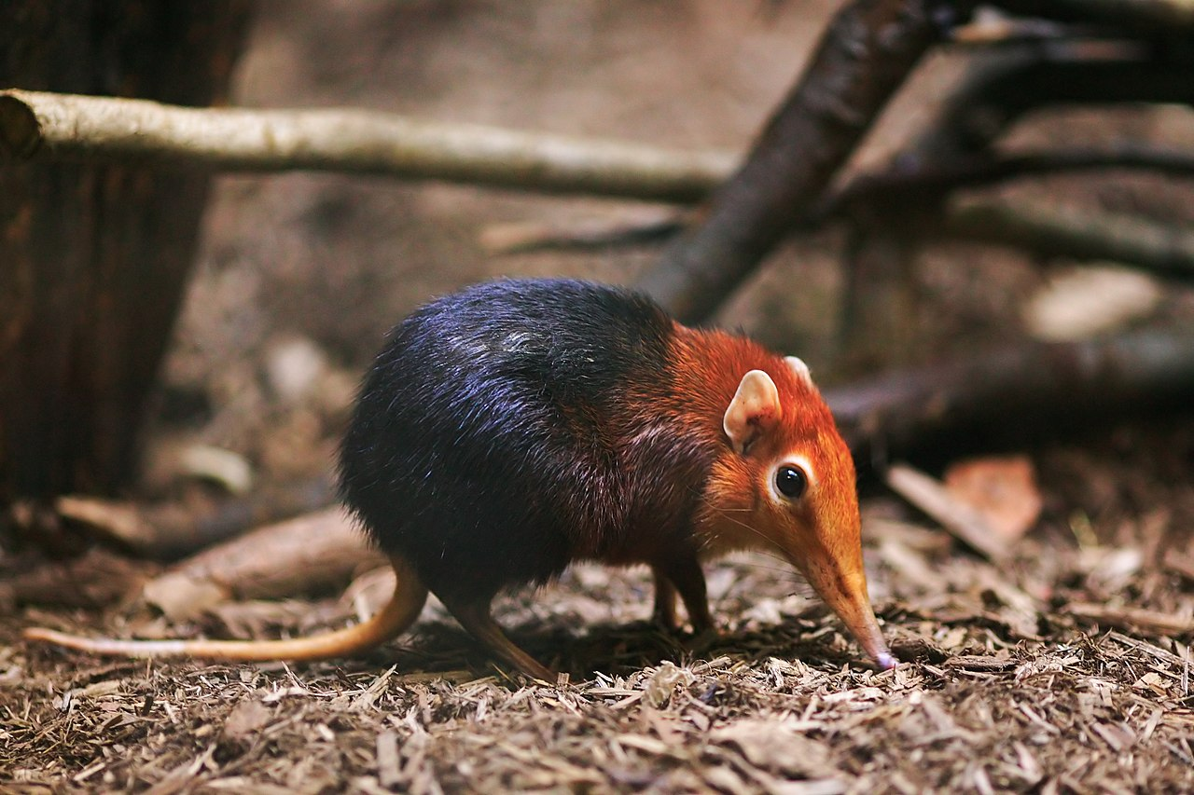
Afrotheria: Macroscelidae (Elephant shrews)
~ 20 species

Slide 10
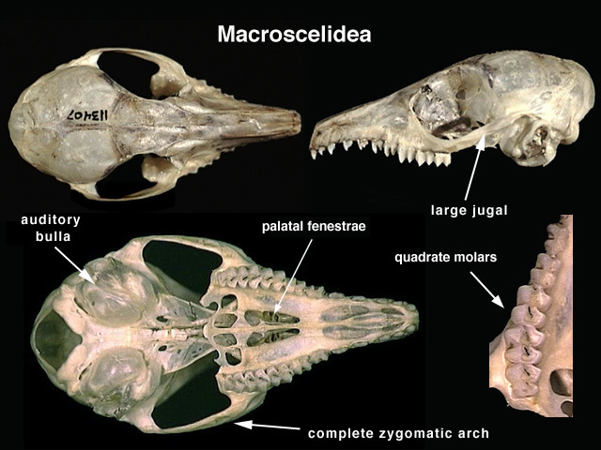
Afrotheria: Macroscelidae (Elephant shrews)
~ 20 species

Slide 11
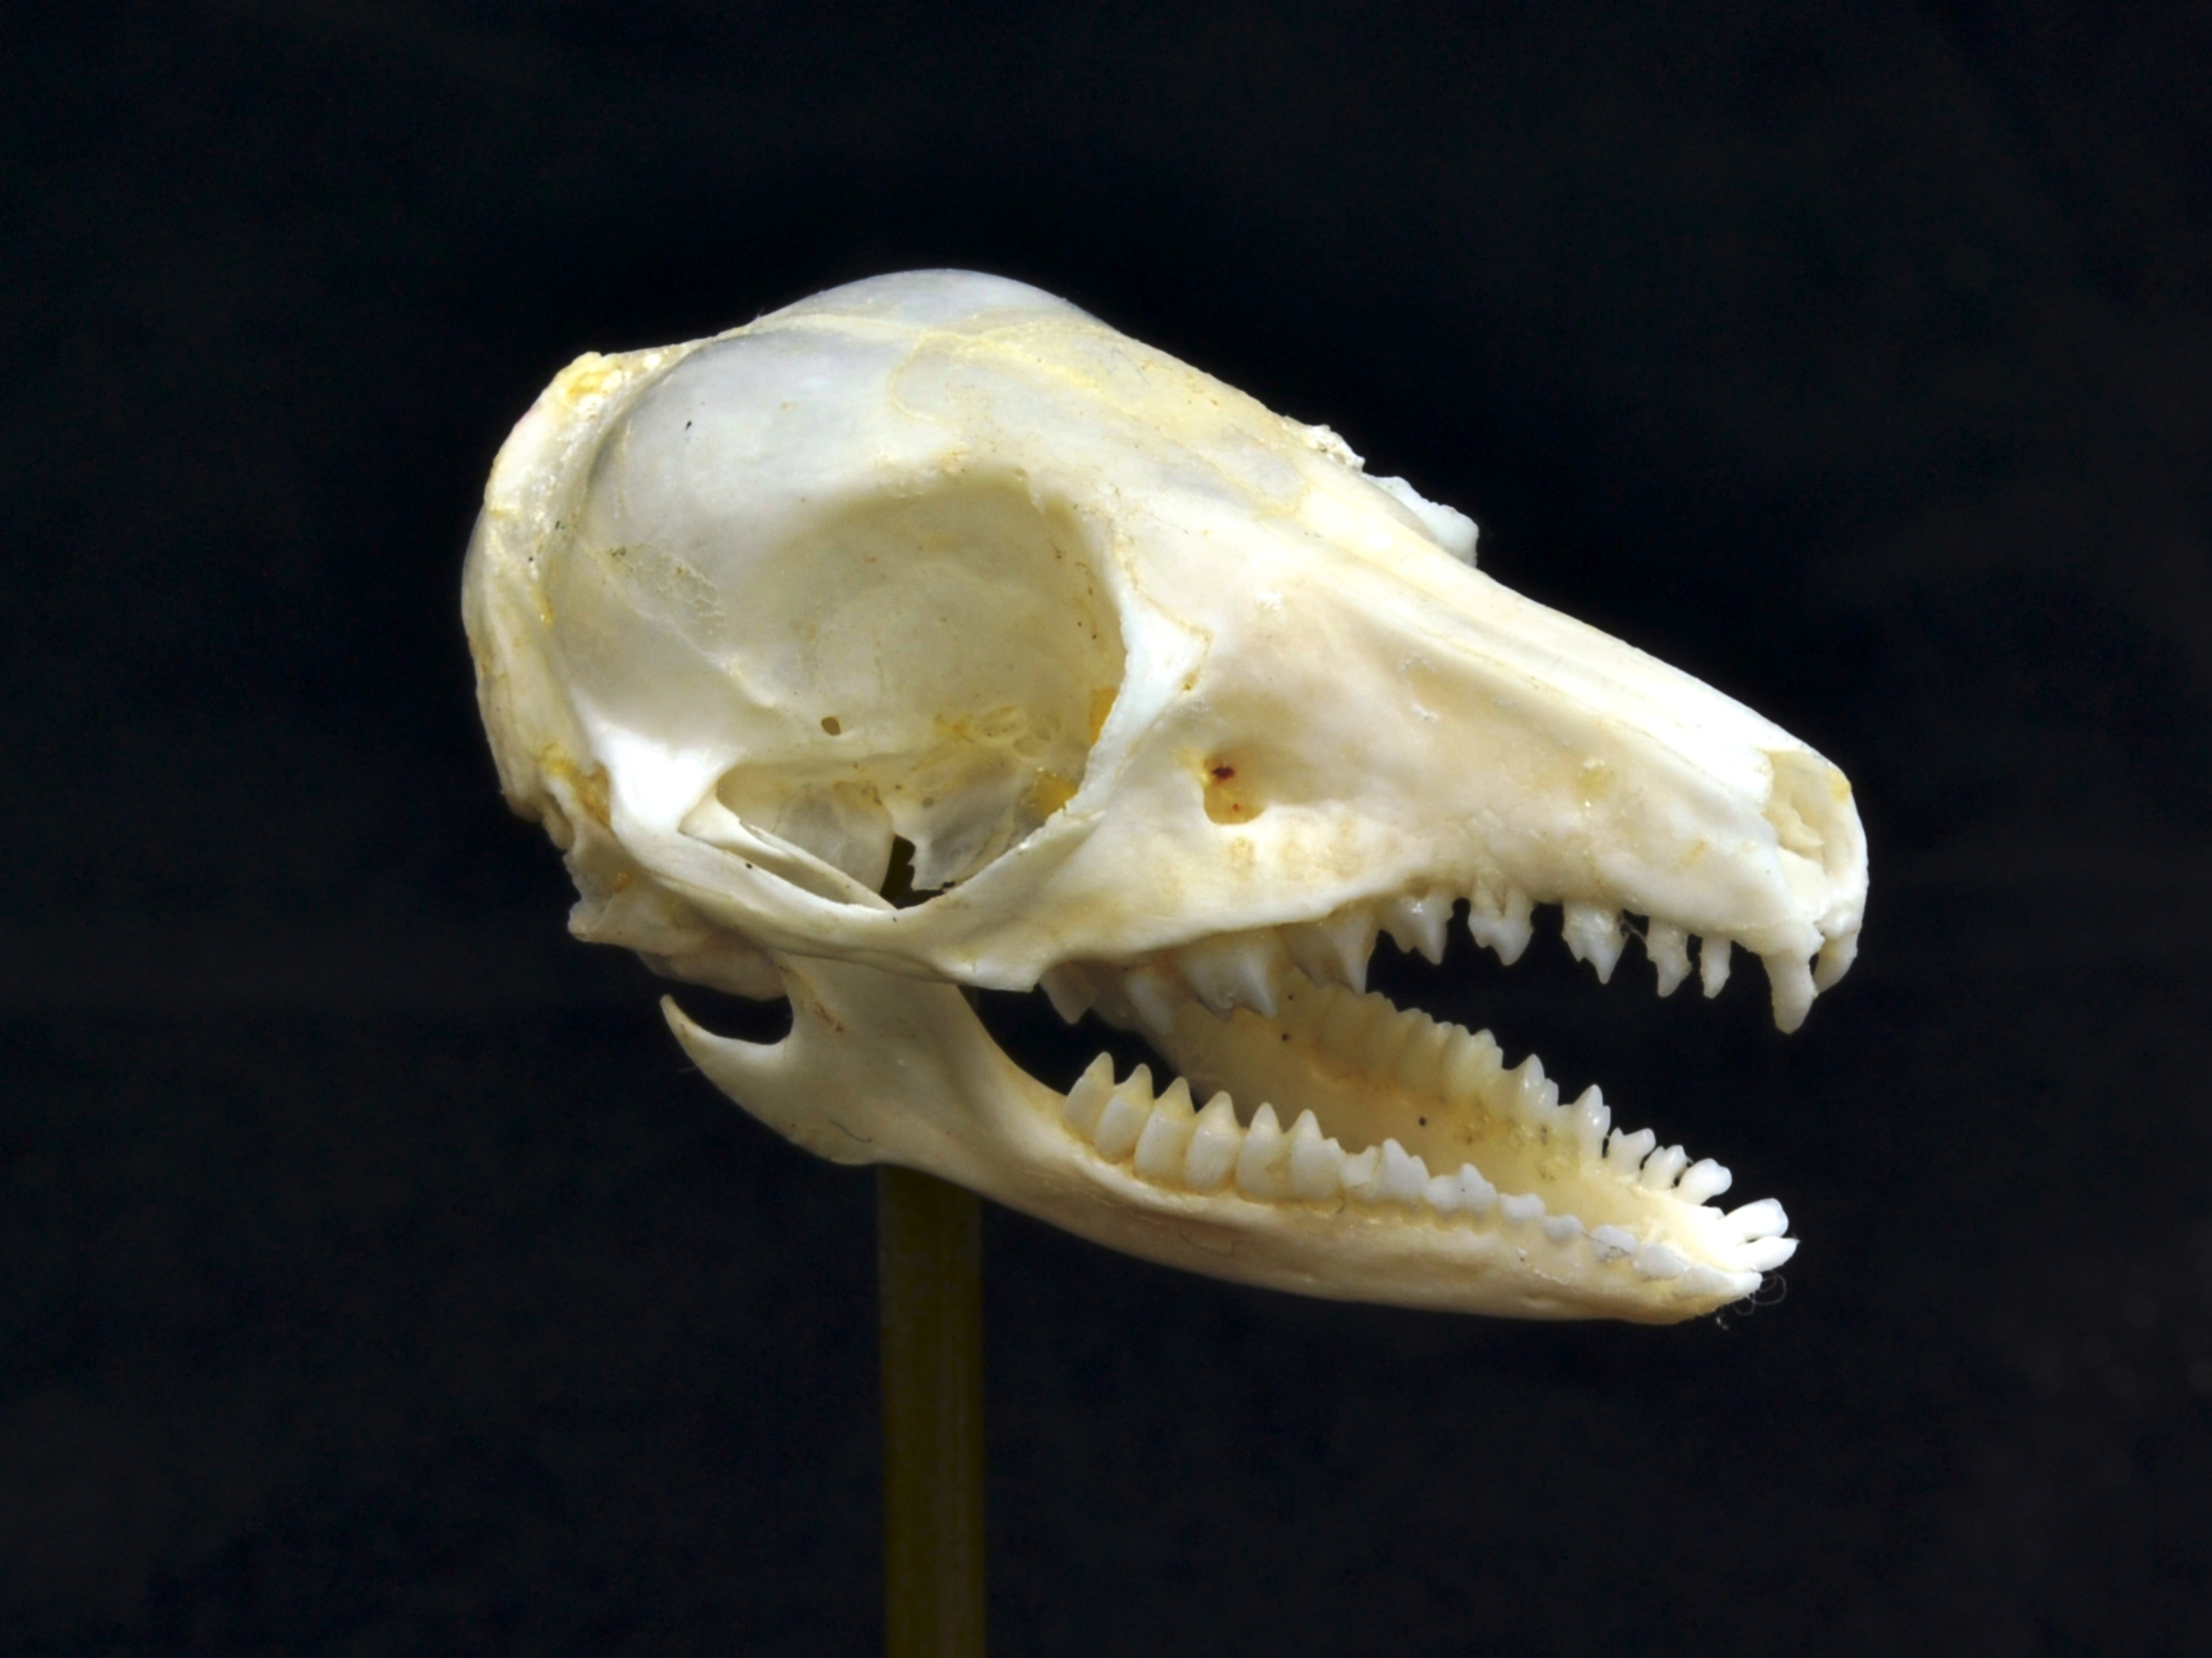
Afrotheria: Macroscelidae (Elephant shrews)
~ 20 species

Slide 12
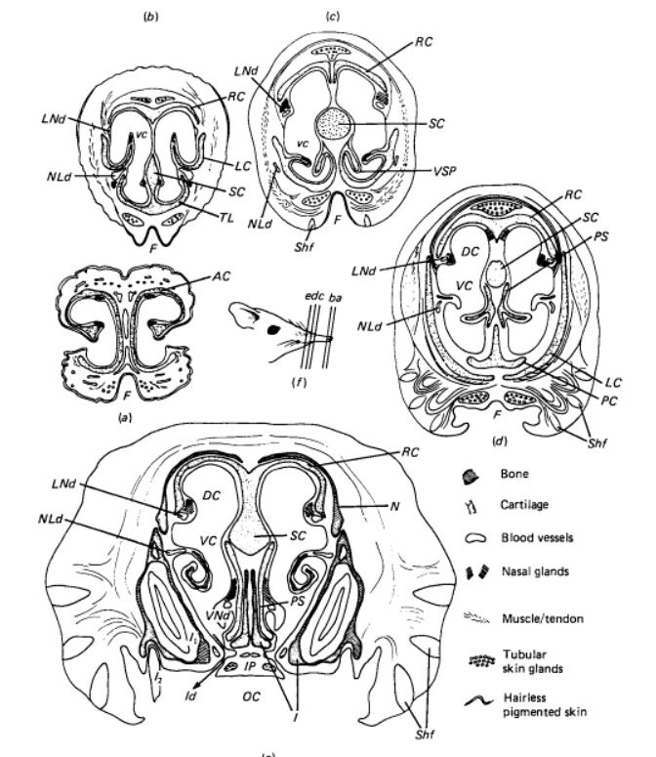
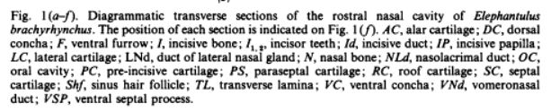
Afrotheria: Macroscelidae (Elephant shrews)
~ 20 species

Slide 13
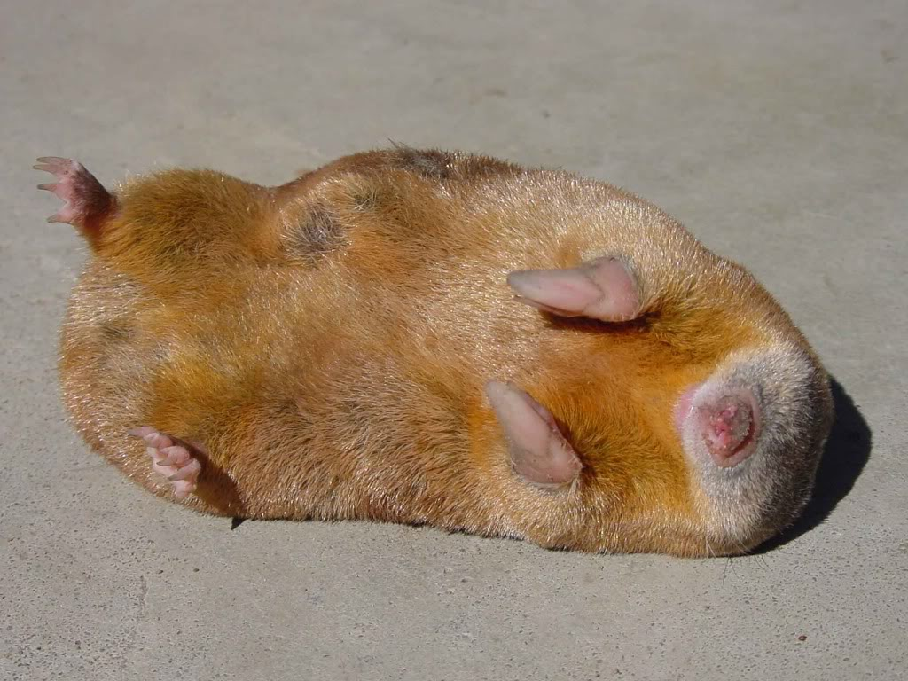
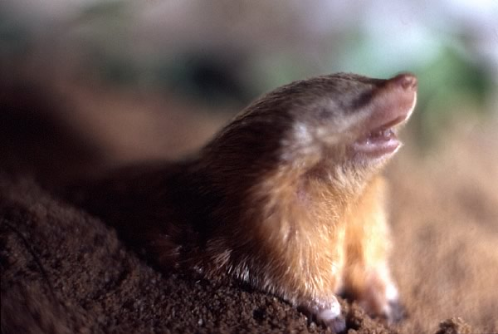
Afrotheria: Chrysochloridae (Golden mole)
~ 21 species

Slide 14
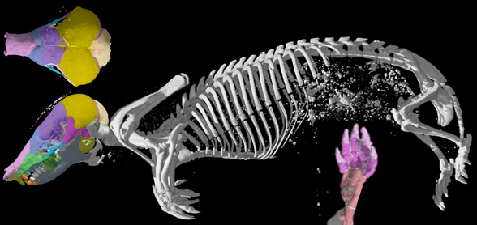
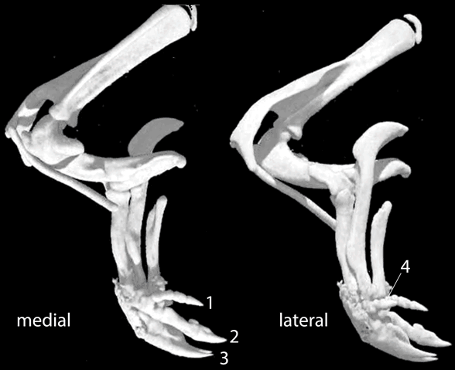
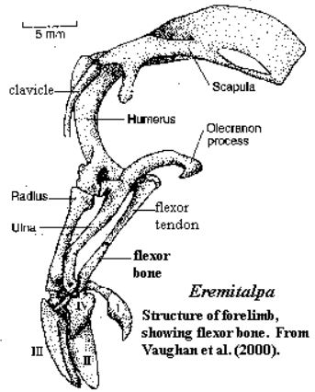
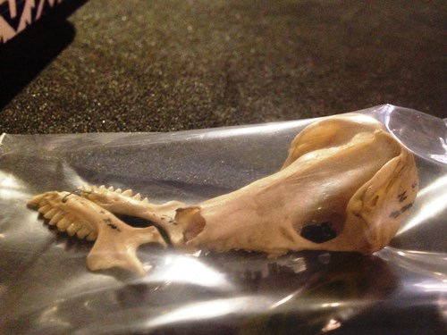
Afrotheria: Chrysochloridae (Golden mole)
~ 21 species

Slide 15
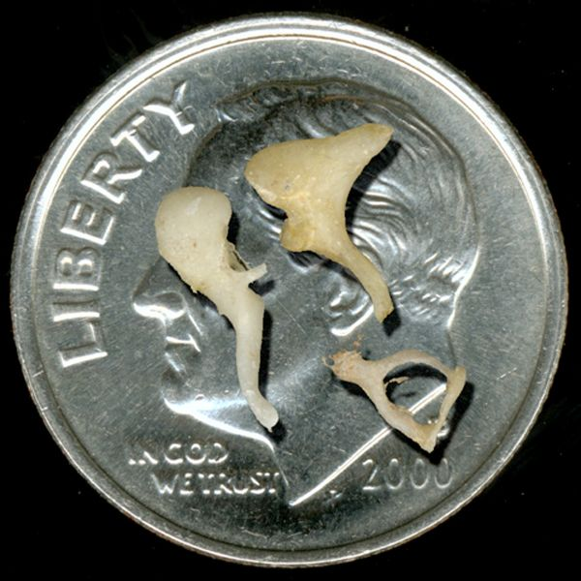
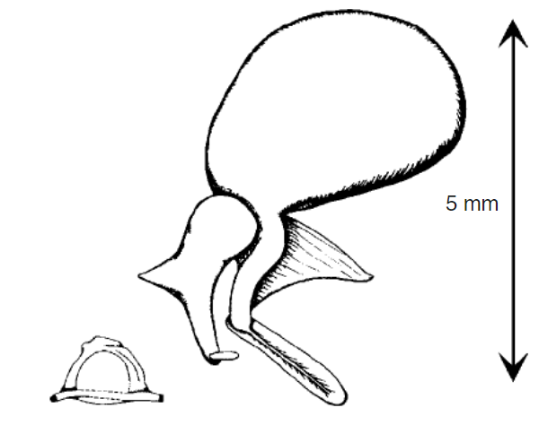
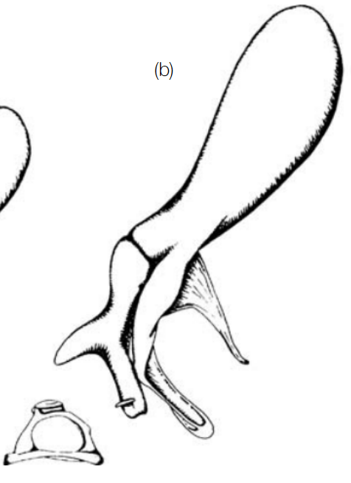
Afrotheria: Chrysochloridae (Golden mole)
~ 21 species
Notes:
Human malleus is on average ~6.4mm
Grant’s Golden Mole (Eremtalpa) has inner ear ossicles about as long and notably more massive. Common in other species too

Slide 16
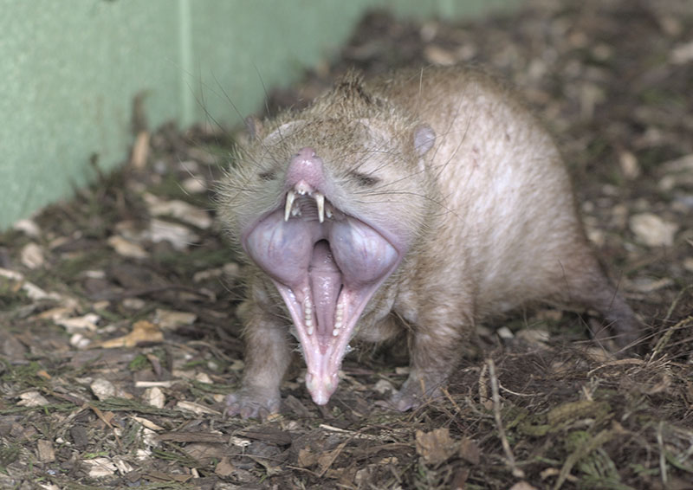
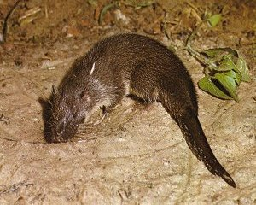
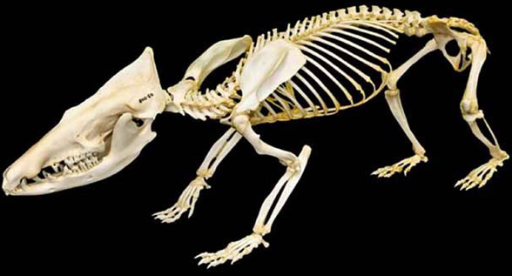
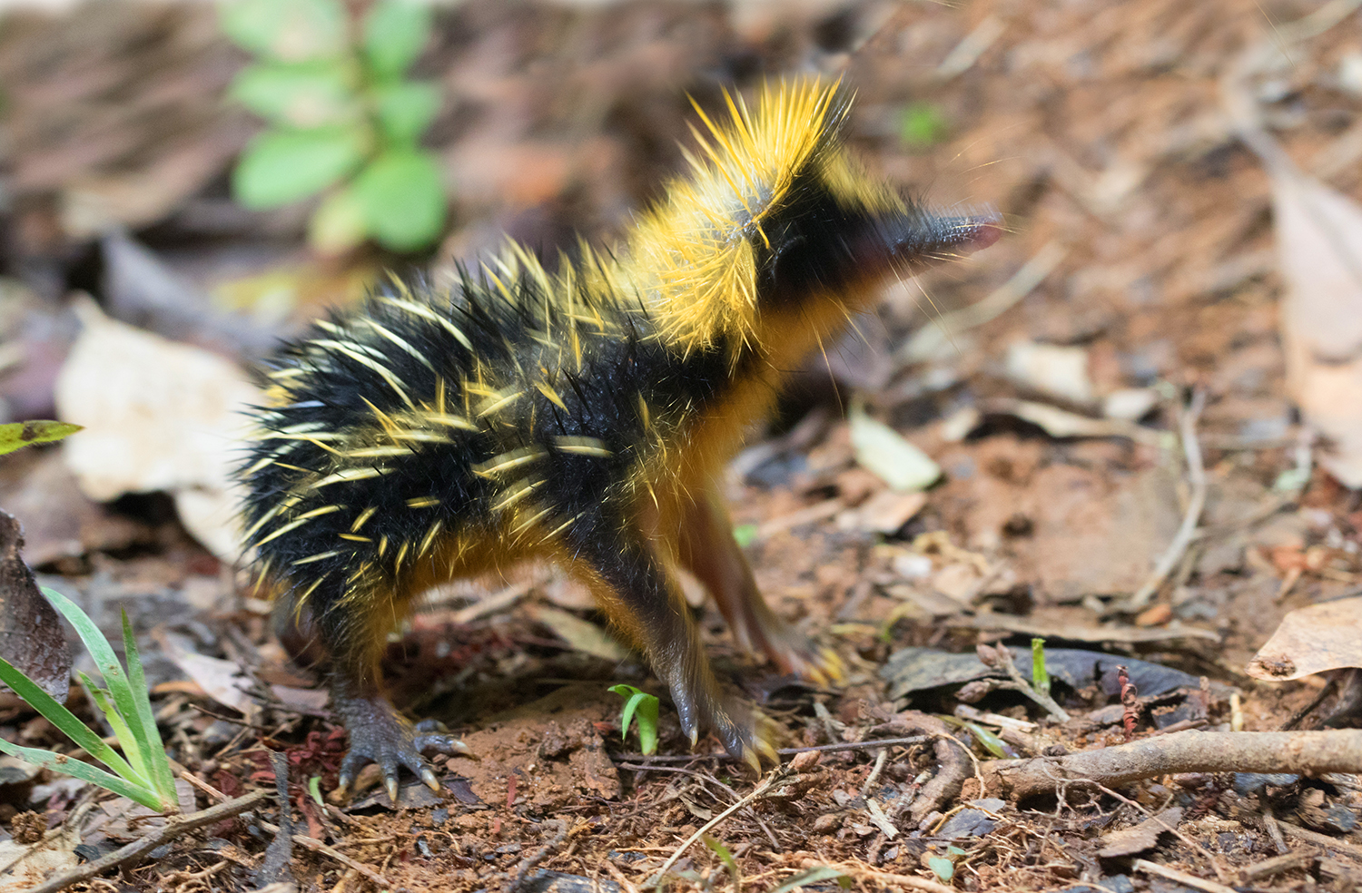
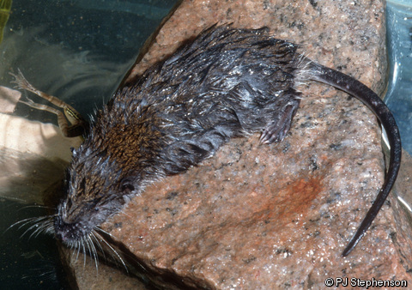
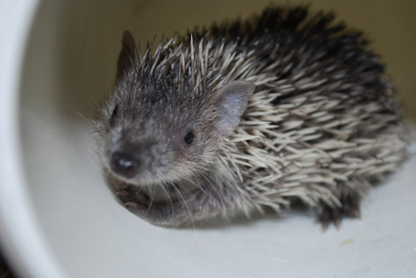
Afrotheria: Afrosorcida: Tenrecs
~ 35 species

Slide 17
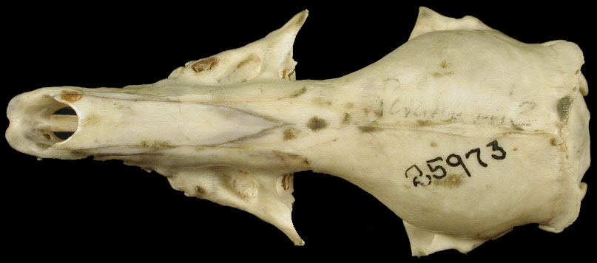
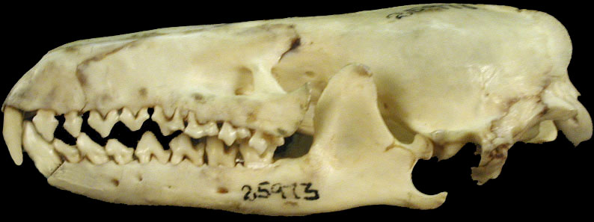
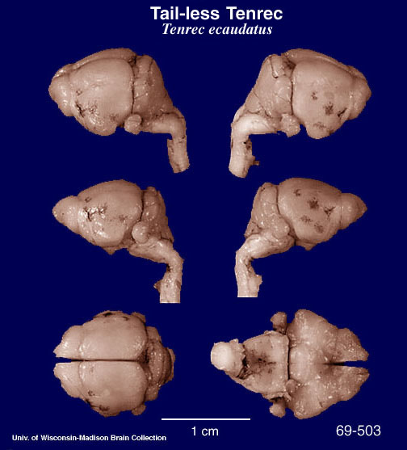
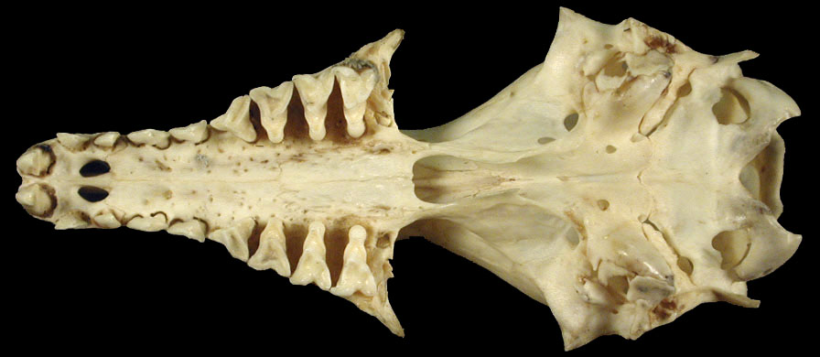
Afrotheria: Tenrecs
~ 35 species
Africa
& Madagascar

Slide 18
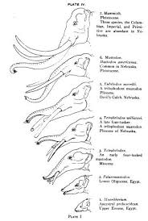
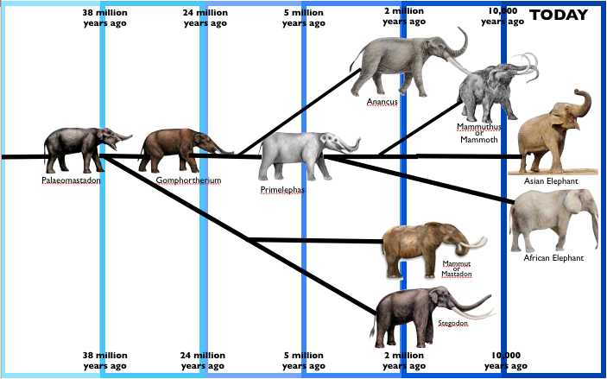
Afrotheria: Paenungulata: Proboscidia

Slide 19
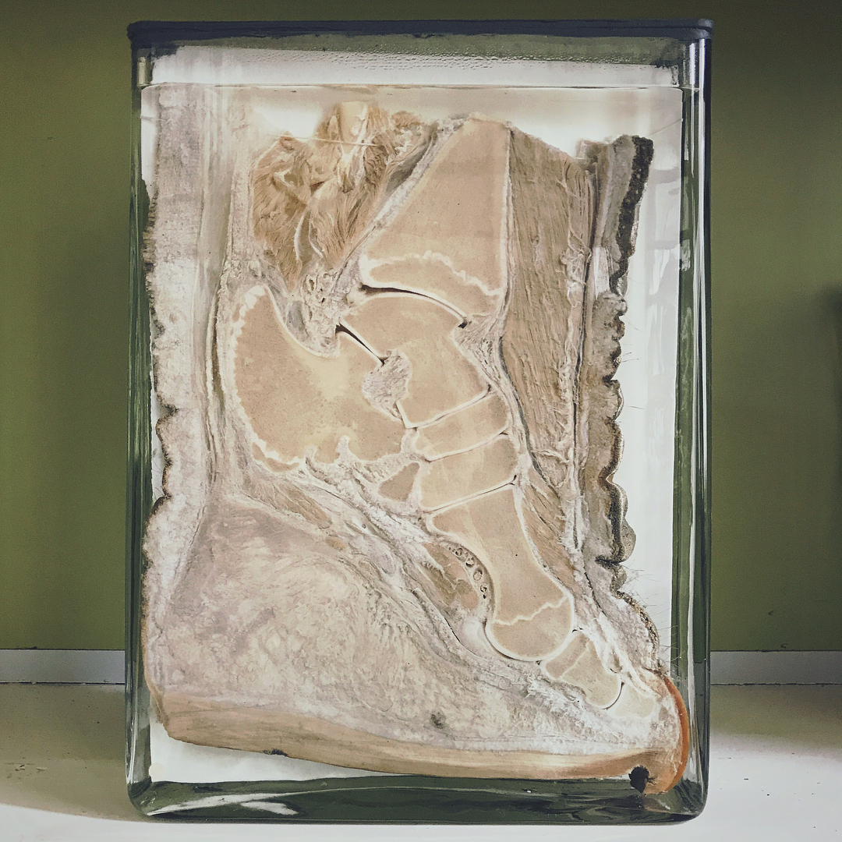

Afrotheria: Paenungulata: Proboscidia
Notes:
https://whatsinjohnsfreezer.com/2015/09/23/elephant-feet-2/

Slide 20

Afrotheria: Paenungulata: Proboscidia
Notes:
https://whatsinjohnsfreezer.com/2015/09/23/elephant-feet-2/

Slide 21


Slide 22


Afrotheria: Paenungulata: Proboscidia

Slide 23

Afrotheria: Paenungulata: Proboscidia

Slide 24

Afrotheria: Paenungulata: Proboscidia

Slide 25


Afrotheria: Paenungulata: Proboscidia

Slide 26







Afrotheria: Paenungulata (Hyrax)
4 species

Slide 27




Afrotheria: Paenungulata: Sirenia
3 manatees (Trichechus)
1 dugong (Dugong)

Slide 28

Afrotheria: Paenungulata: Sirenia

Slide 29




Afrotheria: Paenungulata: Sirenia

Slide 30

Afrotheria: Paenungulata: Sirenia

Slide 31



Afrotheria: Stellar’s Sea Cow
Notes:
Extinct in 1768. Fur traders hunted them and otters. Was it overhunting, or ecological collapse?
No back legs, no fingers?!

Slide 32



Afrotheria: Paenungulata: Sirenia
Pezosiren ~50Ma creature from Jamaica

